Slide 1
Wabash Capstone
Project Notes 04
By: John Danison

Slide 2
What Did I Say I Would Do This Week?
Continue to refine the noise readings in strain gauge.
Continue creating schematics in Altium Designer

Slide 3
What I Have Done Over The Past Week
Wrote code to assist in finding the best physical circuit.
Began going through different configurations attempting to find the most optimal solution.
Started physically constructing the new microphone wire cable.
Attended the meeting with the Wabash team.

Slide 4
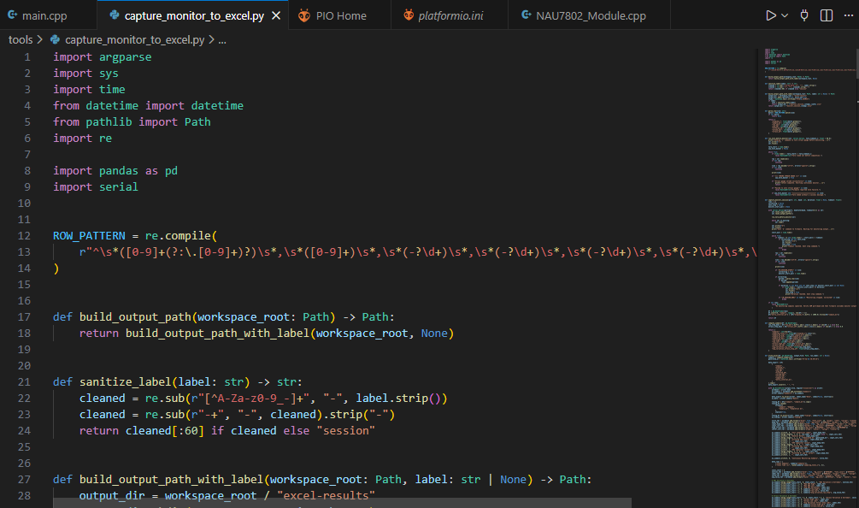
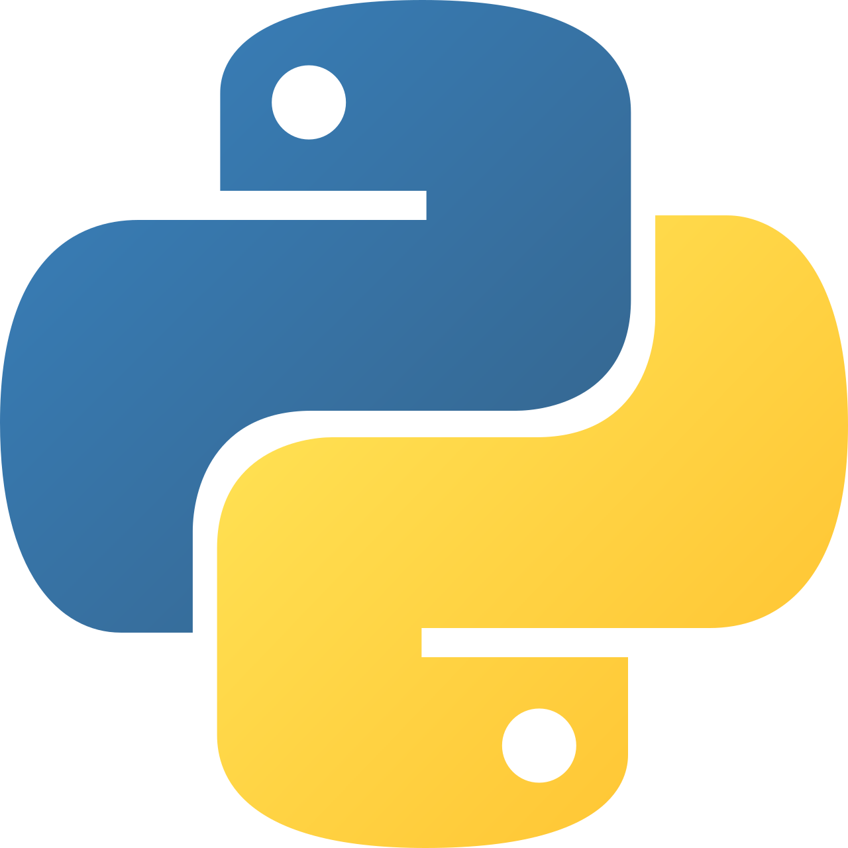
Noise Reduction – Supporting Evidence
Using Python, I wrote code to automatically capture the output of the continuous monitoring mode.
It then imports this data into excel and automatically finds the averages, maxes, mins, and graphs the data over time.
Each iteration I change the physical circuit with hopes to find and prove the most effective option.

Slide 5
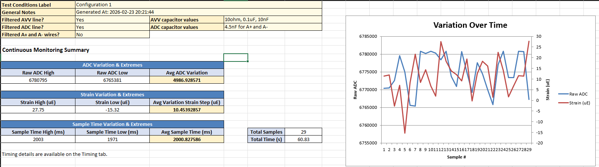
Noise Reduction – Supporting Evidence

Slide 6
Did I Do What I Say I Would Do?
I feel that I am still doing what I said I would do. I do feel that I am starting to get behind.
I am wanting to use this weekend to finish up the noise filtering things in preparation for the physical calibration.
I fell ill during this week but still managed to get myself to lecture and lab on Tuesday. I unfortunately had to miss Lab on Thursday due to this illness.

Slide 7
Plans For Upcoming Weeks
High Level
By EOW:
Continue to refine system sensors & configuration.
Continue to learn how to use Altium Designer.
Continue to show up to class.
Finish Noise Reduction. Prepare for Physical Calibration.
Continue creating schematics in Altium Designer if time allows.

